Slide 1
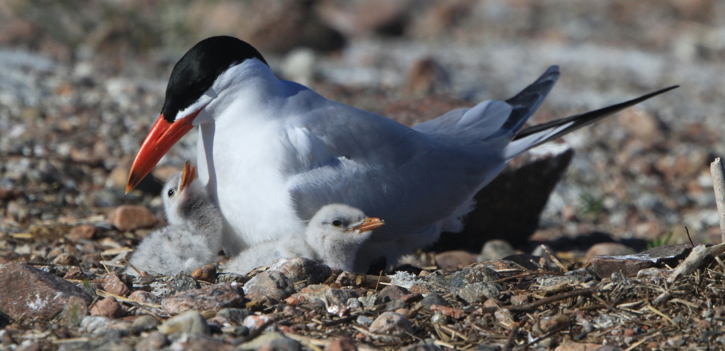
Caspian Terns in Sweden
Population trends 1990-2015
Project Caspian Tern Sweden, Ulrik Lötberg

Slide 2
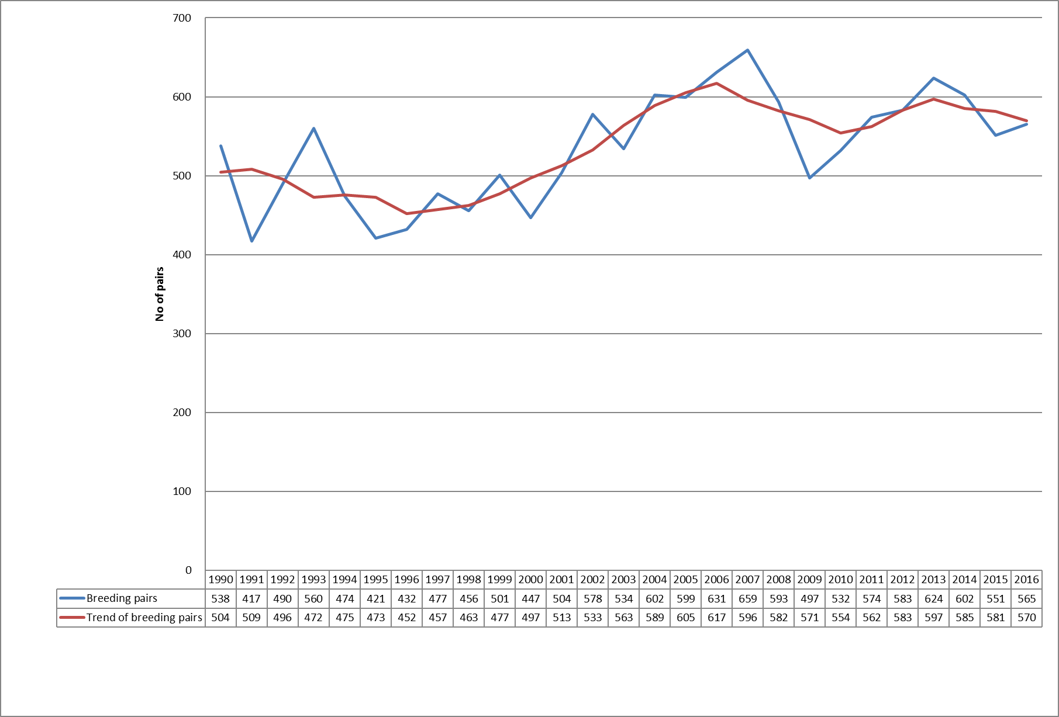
Number of Breeding pairs in Sweden

Slide 3
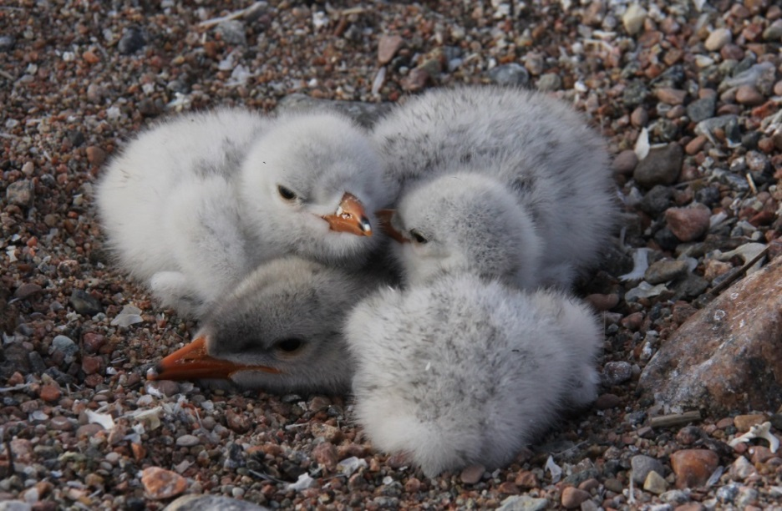
Is there a threat?

Slide 4
Breeding success – a threat to the species

Slide 5
Future?

Slide 6
Breeding success vs No of Pairs

Slide 7
Reduction of breeding success of Caspian Tern in Sweden 1990-2012
1990-1999 2003-2012 Change in % Average number of breeding pairs 477 580 22 Average number of breeding pairs in colonies 408 493 21 Average number of solitary breeding pairs 68 88 28 Average number ringed pullis 484 398 -18 Average number ringed pullis in colonies 444 362 -19 Average number ringed pullis in solitary breedings 41 37 -9 Average number of ringed pullis per breeding pair 1,02 0,68 -34 Average number of ringed pullis per breeding pair in colonies 1,10 0,72 -34 Average number of ringed pullis per solitary breeding pair 0,62 0,42 -32

Slide 8
Swedish colonies vs Finnish colonies
Total number of pairs Sweden vs Finland => Finland has 50% more pairs than in Sweden

Slide 9
